Slide 1
Monocular Depth Estimation for Endoscopic Applications
Phase 1
Vicente Lagarrigue

Slide 2
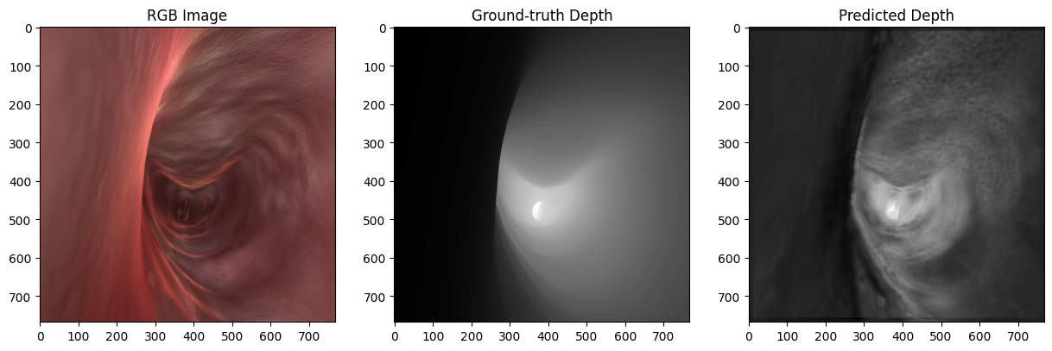
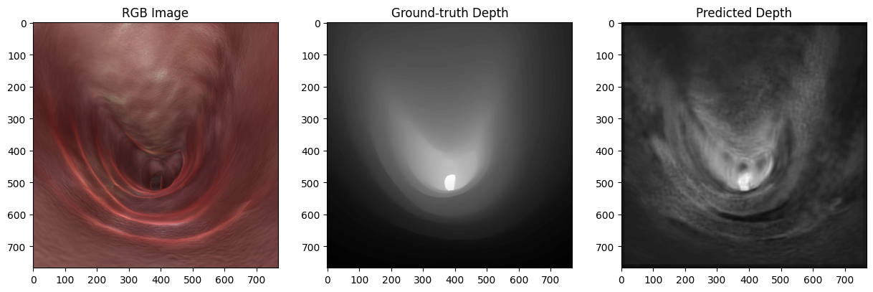
Method
Incorporating techniques and information from the original Depth Estimation Model provided by Keras, I built my own sequential model and trained it on the synthetic data. Initial results were not promising, but through refinement of the model’s training parameters and predicted image smoothing, favorable results were achieved.
Initial results

Slide 3
Problems and Solutions
Problem: Model from Keras
Leaky ReLU activation function
Vanishing gradients due to negative values
Solution: ReLU
Eliminates vanishing gradient issue
Increased learning rate during backpropagation
Takes more resources
Problem: Depth map roughness
Dimpling due to uneven surfaces
Lack of hard edges when present in ground-truth map
Solution: Bilateral Filter and Gaussian Smoothing
Bilateral filtering helps maintain edges while smoothing within larger areas
Gaussian smoothing smooths hard edges and dimpling, improves quality of point-cloud

Slide 4
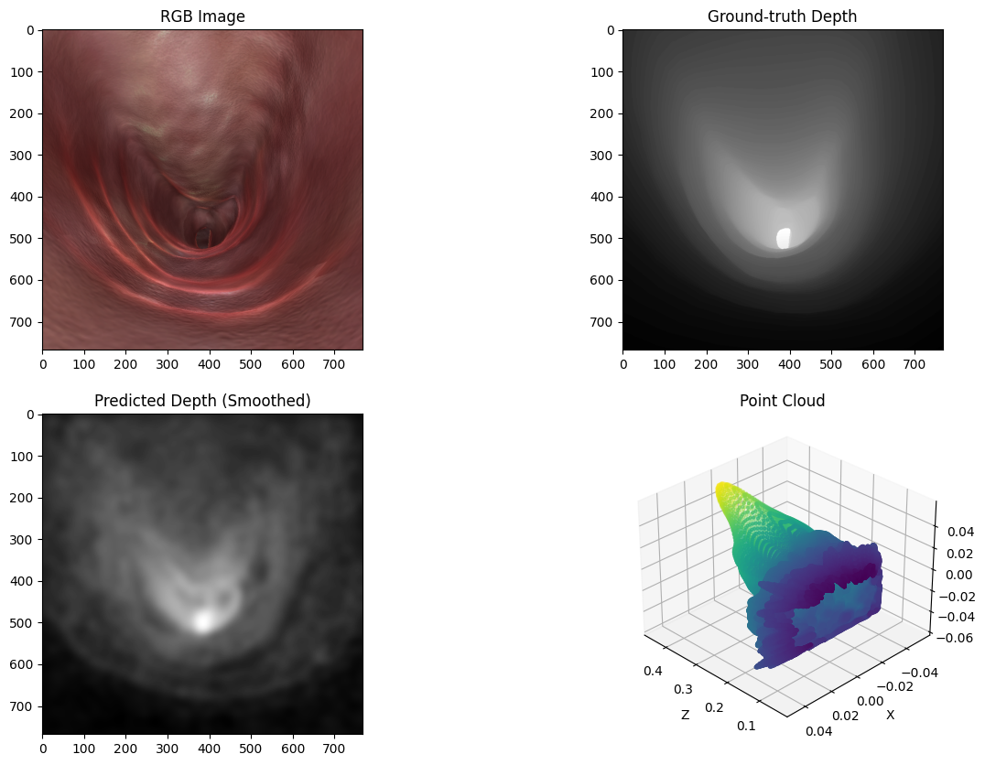
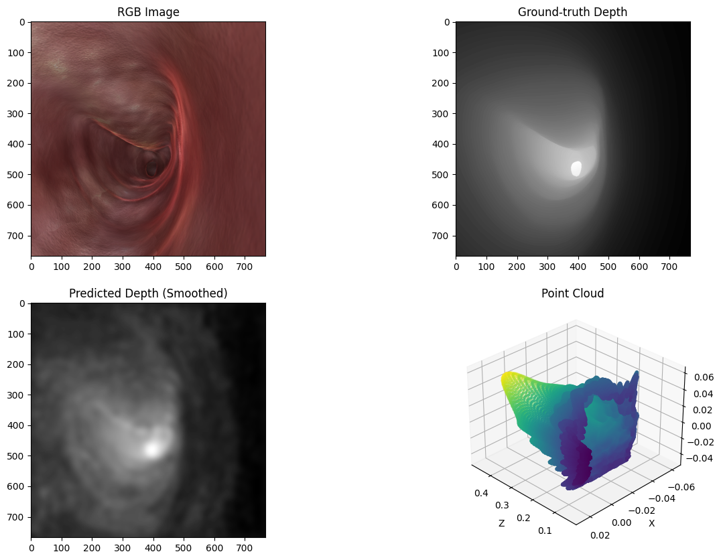
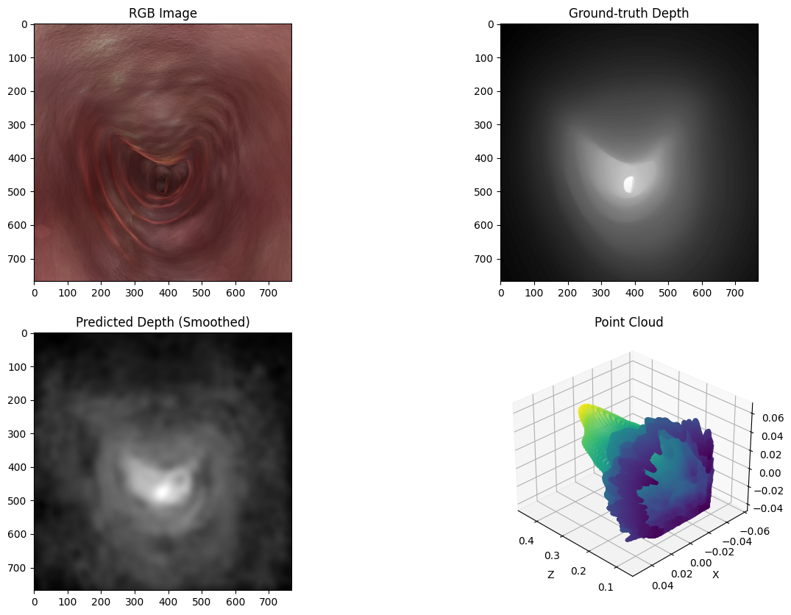
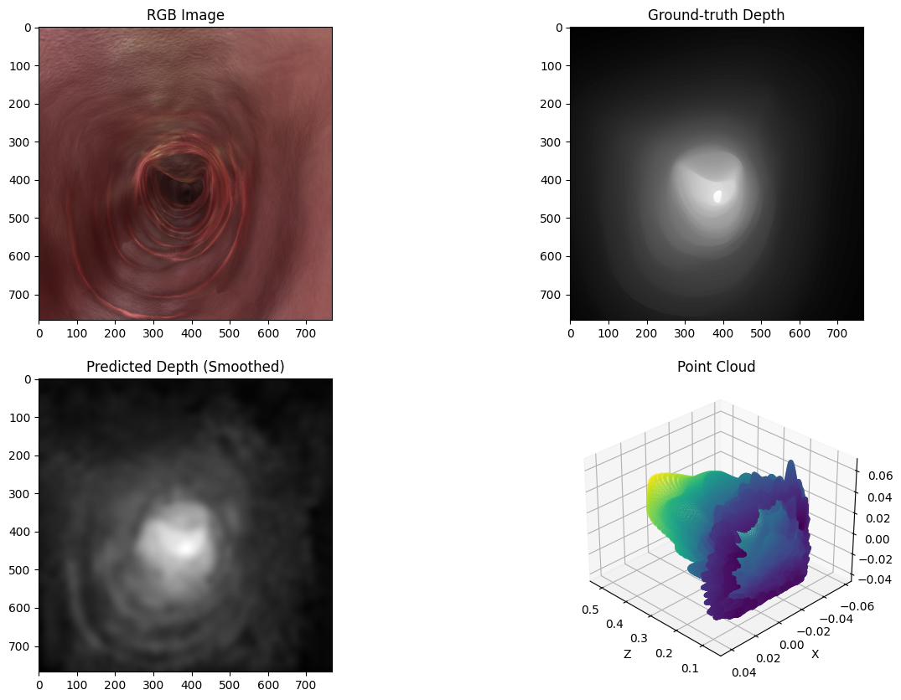
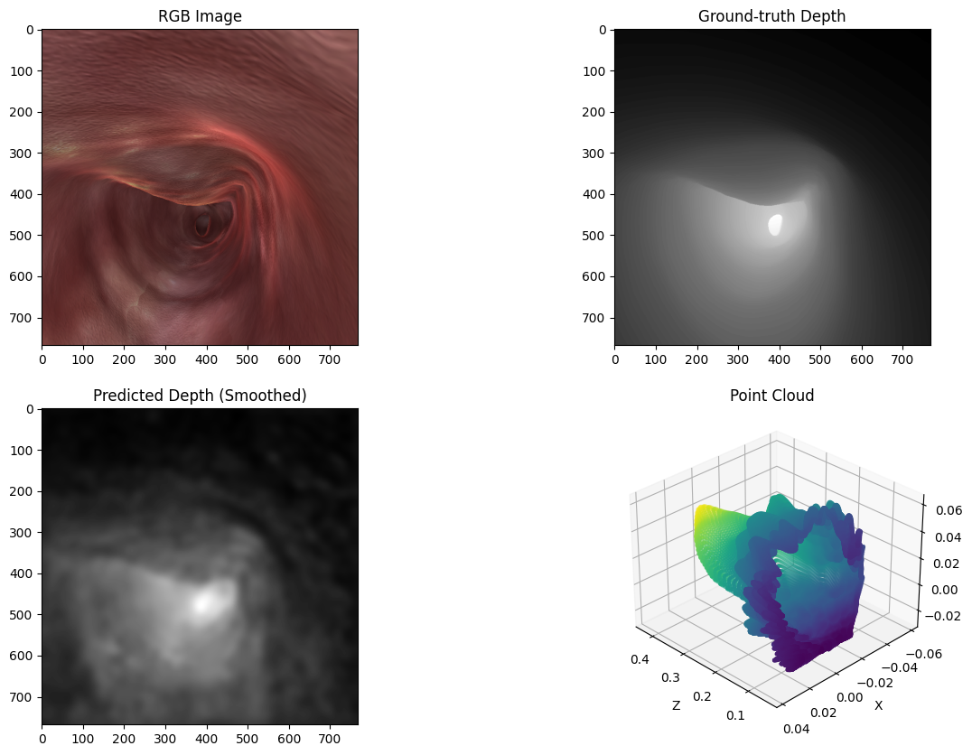
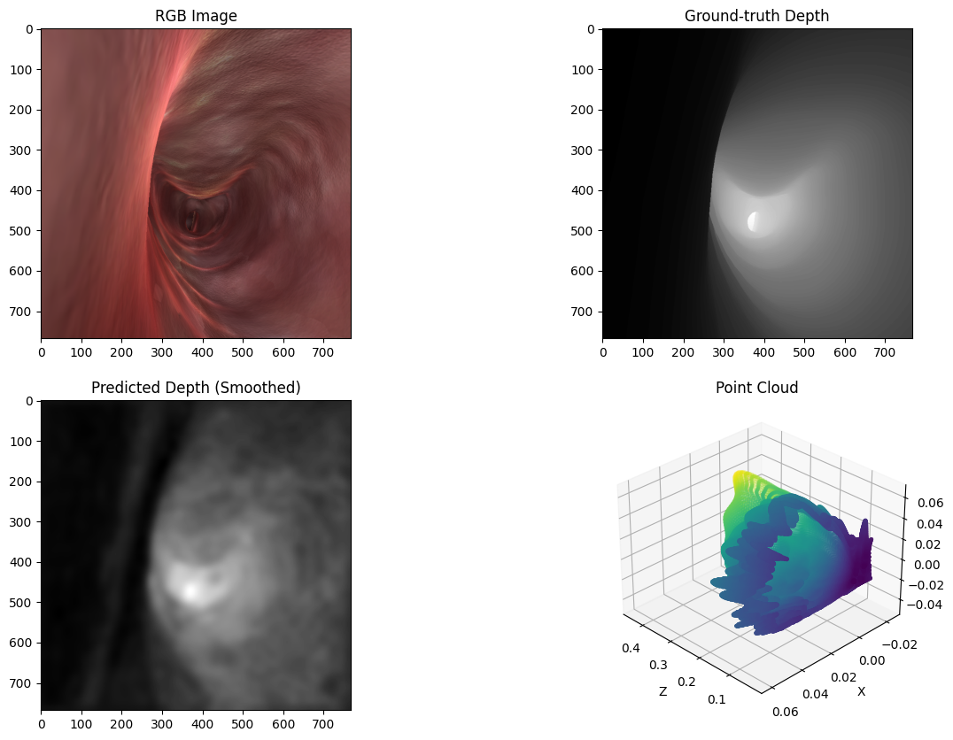
Current Results

Slide 5
Next Steps
Improve point-cloud mapping function to increase smoothing, remove random spiking
Map RGB images onto point cloud, 3D model creation
Begin training model on real data set
Normalize real data set
Lots of testing for 3D modelling

